Slide 1
Unsupervised Learning
- Sumit Sahu

Slide 2
Supervised vs. Unsupervised Learning
Sessions before this focused mostly on supervised learning methods such as regression/classification.
What if we only have Input (X1, X2..) but we don’t have Y
Can happen with newly launched business
Can we still do anything with this data?
Supervised Learning
Here we have Input (X1, X2..) as well as Output (Y) for every object Predictive Analytics can be done since you have Y

Slide 3

Unsupervised Learning
Here, we don’t need to supervise the model using Y, instead model will find information on its own.
We only have X1, X2, . . . , Xp and Y is missing
Usage:
Segmentation / Clustering
Dimension Reduction
Relationship mining
Recommender System
Example:
Find target segments for a newly launched SUV in market

Slide 4
Example - Clustering for Market Segmentation
The Problem:
A new car manufacturer is launching a latest SUV in market. Whom and how to target customers?
Given we have a dataset:
Our goal here would be to find subgroups which might be receptive to a particular form of advertising or more likely to make a purchase
Email | Age | Gender | City | Income | Occupation

Slide 5
Clustering
Clustering is an exploratory method for identifying homogenous groups, subgroups or clusters in data
Similar records in data should belong to the same cluster
Dissimilar records should belong to different clusters

Slide 6
Clustering
Find underlying patterns in data by understanding the subgroups in the population
How many subgroups exists in population
Common properties in subgroup
Subgroup sizes (Check outliers)

Slide 7
Clustering methods:
K-means clustering
Hierarchical clustering - Agglomerative
Mean-Shift Clustering
Density-Based Spatial Clustering
Expectation–Maximization (EM) Clustering
There are many more interesting methods are coming up but for the scope of this session we will discuss 1 and 2

Slide 8
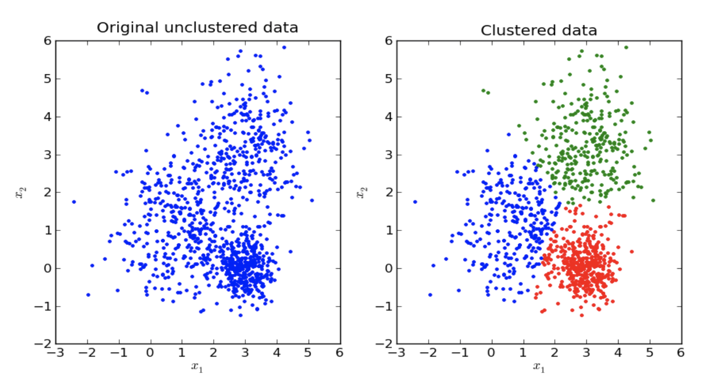
K-means clustering
We seek to partition the observations into a pre-specified number(K) of clusters. Here in example below k=3
The goal is to improve homogeneity within subgroups and decrease homogeneity between subgroups

Slide 9

K-means clustering Algorithm
Randomly assign objects to k clusters and compute centroid
Assign each observation to their closest centroid, based on the Euclidean distance between the object and centroid.
For each of the k clusters:
Update cluster centroid by calculating new mean values of all datapoints in cluster.
Centroid of kth cluster is a p dimensional vector containing the means of all variables for the observations in the kth cluster; p is the number of variables.
Iteratively minimize the total within sum of square. Stop until cluster assignments stop changing or the maximum number of iterations is reached

Slide 10
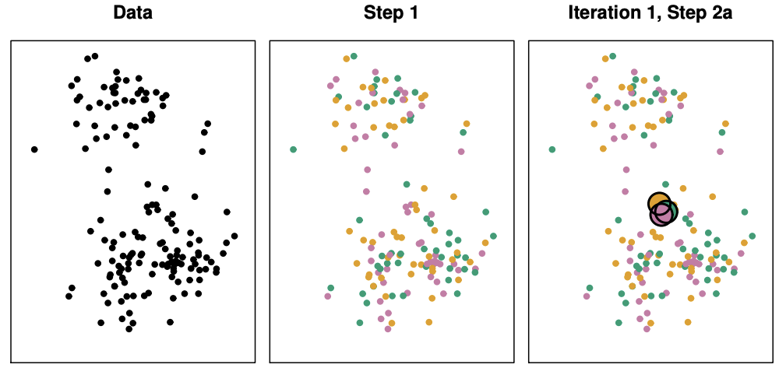
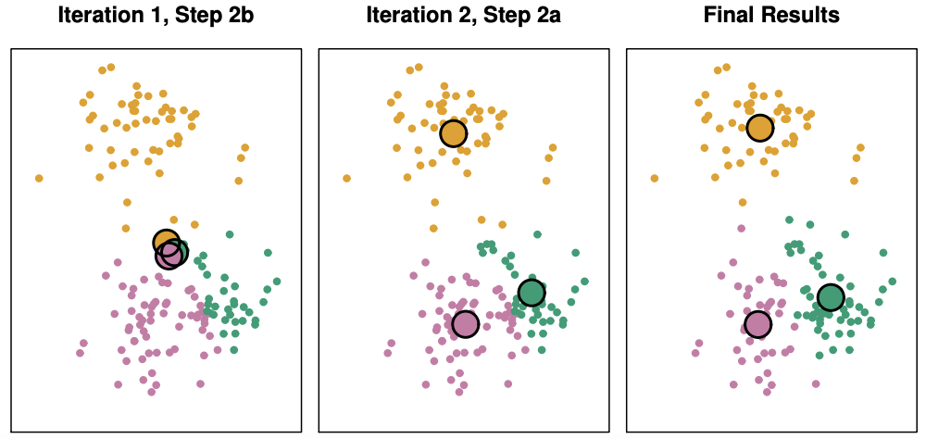
Example The progress of the K-means algorithm with K=3 (Cluster – Centroid – Cluster – Centroid (loop))
Data | Step 1 | Iteration 1, 2a | Iteration 1, 2b | Iteration 2, 2a | Final Results
The observations are shown | Each observation is randomly assigned to a cluster | The cluster centroids are computed. These are shown as large coloured disks. Initially the centroids are almost completely overlapping because the initial cluster assignments were chosen at random. | Each observation is assigned to the nearest centroid | Step 2(a) is once again performed, leading to new cluster centroid | The results obtained after 10 iterations

Slide 11
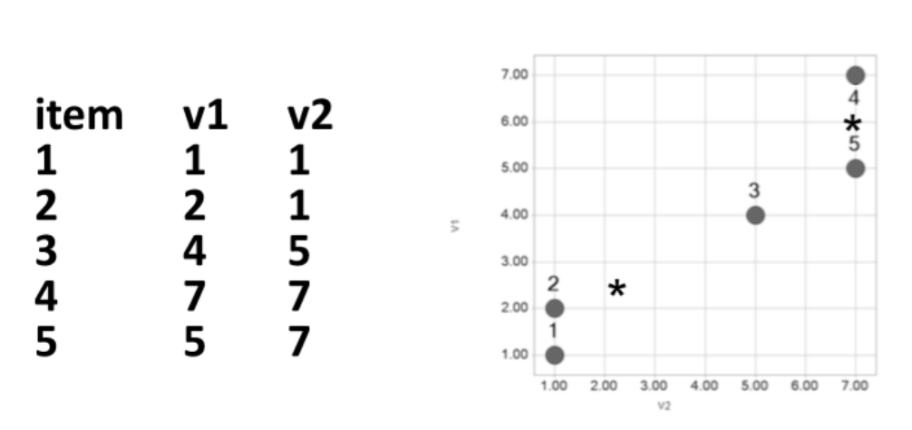
Math behind K-means
Assign random clusters and then calculate the centroid:
Example K = 2
Start with cluster A: 1,2,3 and cluster B: 4,5
Compute cluster centroids

Slide 12
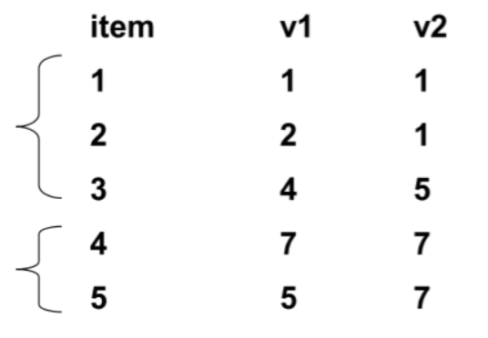
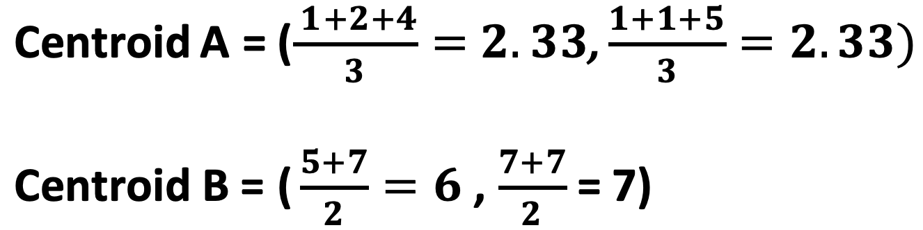
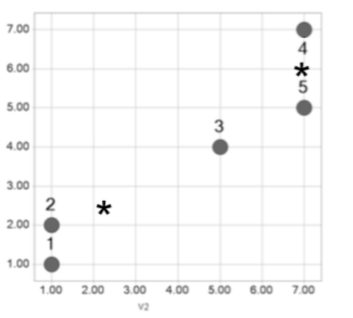
Math behind K-means
Compute Centroids of the Clusters:

Slide 13
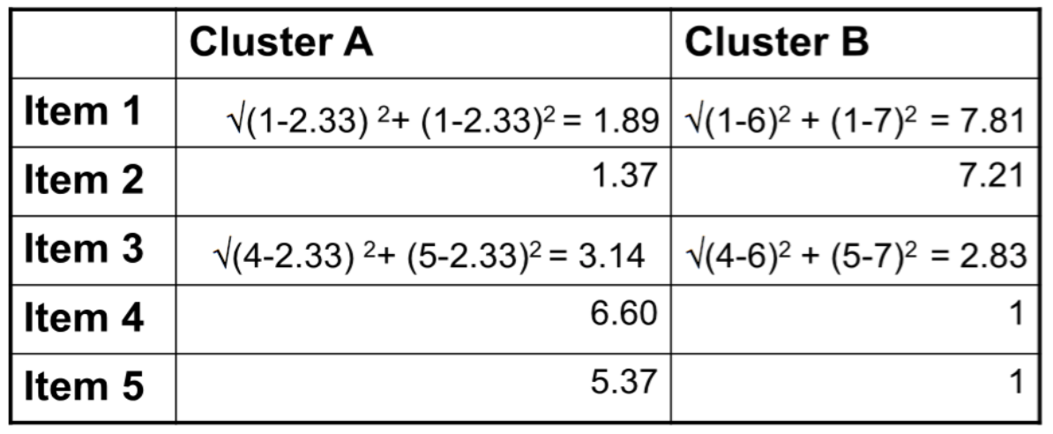


Math behind K-means
Reassign Records:
Compute Euclidean distance of each record from each centroid, and re-assign to closest cluster
We found Item 3 to be closer to Cluster B than Cluster A, hence reassign

Slide 14
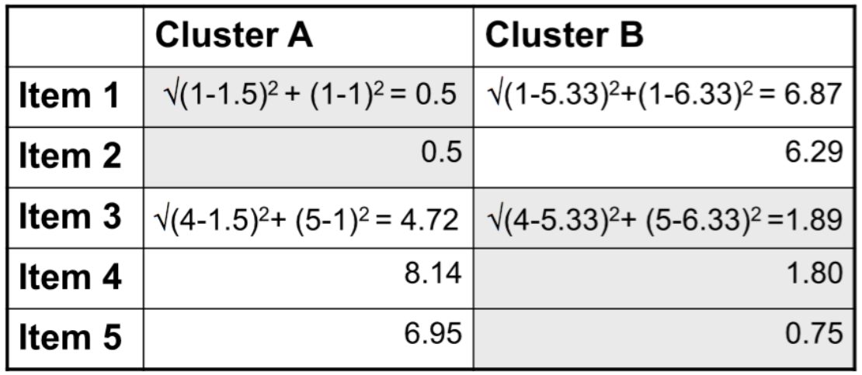
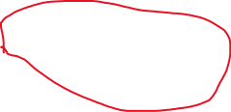

Math behind K-means
First Iteration Results :
Cluster A: 1,2 Cluster B: 3,4,5
Re-compute centroids
Centroid A = (1.5, 1), Centroid B = (5.33, 6.33)
Re-compute distances of records to centroids
This is where it stops!! Since points are assigned to right clusters and centroid gets fixed!

Slide 15

Determining optimal value of K:
There are scientific methods which help us in determining the optimal value of K. Selecting one from them is Art.
Few methods:
Elbow Method
Average Silhouette Method
Calinkski-Harabasz Index
We will discuss Elbow method here

Slide 16
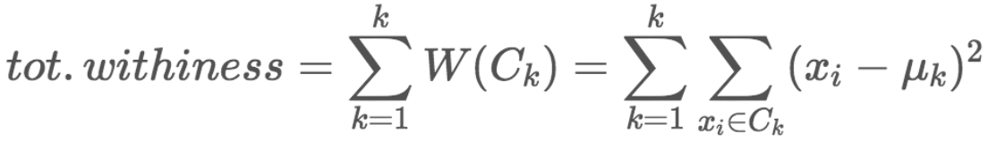
Elbow method:
Measures the sum of squared distances of points from their assigned center for the values of K and helps in identifying the break point

Slide 17
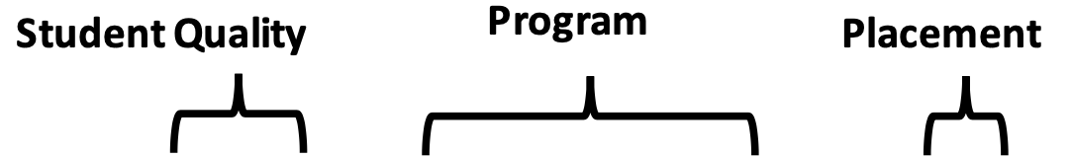
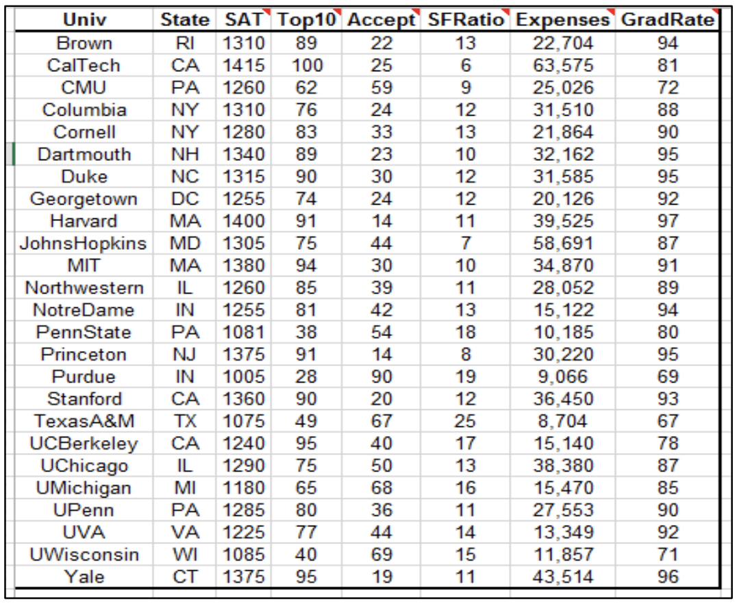
Case Study University wants to figure out their actual competition! Can you help??
Data for 25 undergraduate programs at business schools in US universities in 1995
Datapoints:
Univ – University name
State – State
SAT – SAT score
Top10 - % new fresh men in top 10% of high school class
Accept - % of applicants accepted
SFRatio – student to faculty ratio
Expenses – Estimated annual expenses
GradRate – Graduation rate%
Dataset - Universities_Clustering.csv
Code Block - Clustering.ipynb

Slide 18
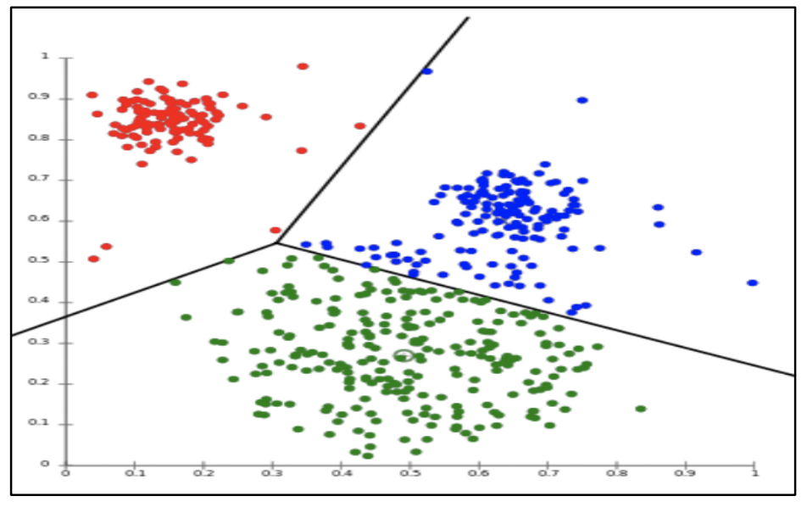
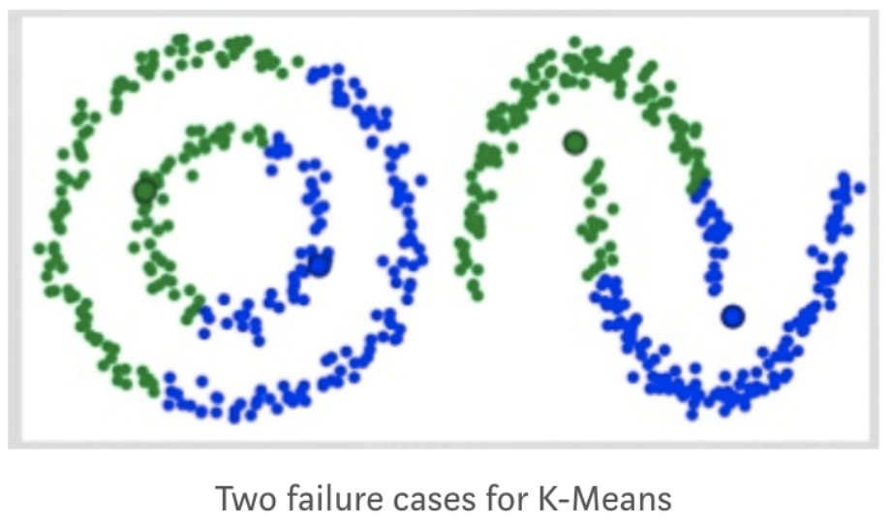


Challenges with K-means:
Less deterministic
Different starting points leads to different results
Run several times with random starting points
Pick clustering that yields smallest aggregate distance
Selecting number of clusters beforehand
Limited to linear boundaries, will fail for more complicated boundaries

Slide 19

Hierarchical Clustering
One of the most popular clustering technique for identifying groups in the dataset
Not required to pre-specify the number of clusters to be generated as is required by the k-means approach.
Hierarchical clustering has an added advantage over K-means clustering - results in an attractive tree-based representation of the observations called a dendrogram.

Slide 20
Hierarchical Clustering - Types
Agglomerative clustering
Works in a bottom-up manner.
Good at identifying small clusters
Divisive clustering
Works in a top-down manner.
The algorithm is an inverse order of Agglomerative
Good at identifying large clusters
Here we will discuss Agglomerative clustering in detail

Slide 21
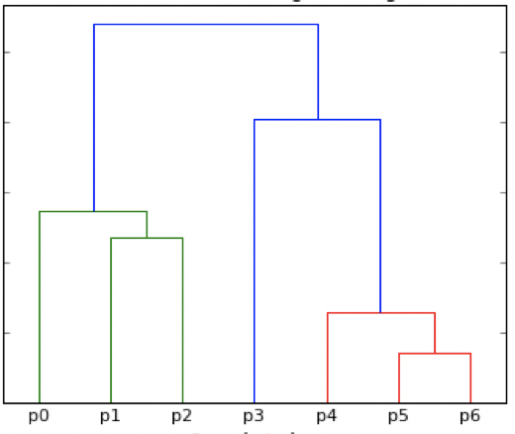
Hierarchical methods - Agglomerative:
This is the most common type of hierarchical clustering and refers to the fact that a dendrogram is built starting from the leaves and combining clusters up to the trunk.
Sequentially merge group of records until all are put in one large group

Slide 22

Hierarchical Agglomerative Clustering Algorithm
Start with each point in its own cluster
Identify the closest two clusters and merge them
Repeat
Ends when all points are in a single cluster.

Slide 23
Agglomerative Algorithm working:
Compute the proximity/distance matrix between the points
Let each data point be a cluster
Merge the two closest clusters and update the proximity matrix
Repeat point 3 and stop when single cluster remains
Before going further we need to understand first point better
How do we compute distance/dissimilarity between two points/clusters?
How do we calculate distance between two points?
We are using Euclidean distance for this. (Others are – Manhattan, Cosine etc.)
How do we calculate distance between two clusters?

Slide 24


How do we calculate distance between two clusters? Any Ideas??

Slide 25
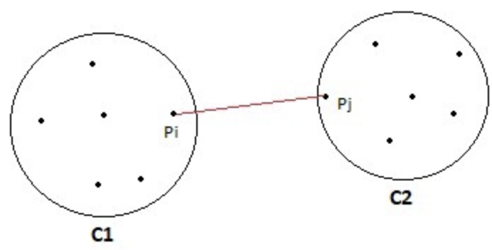
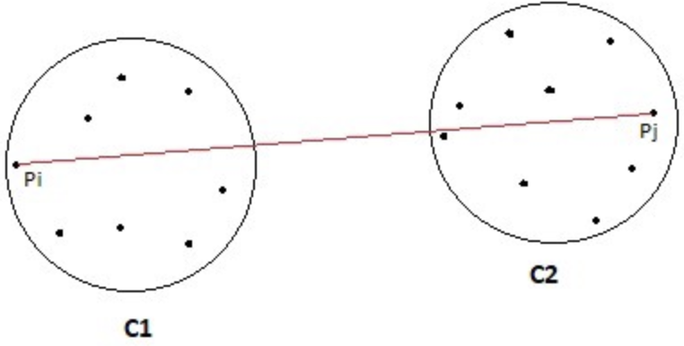
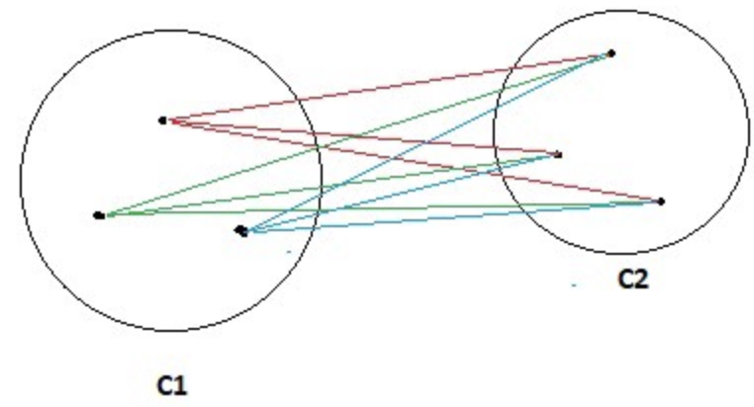
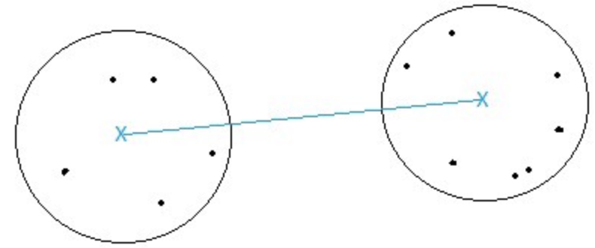
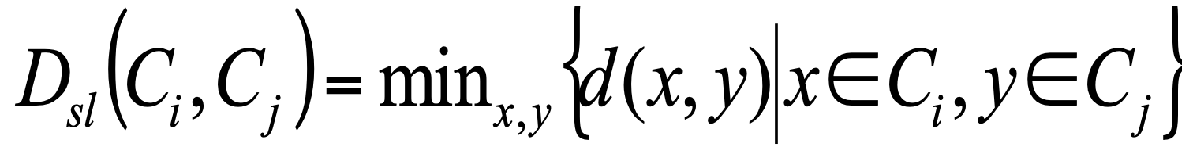
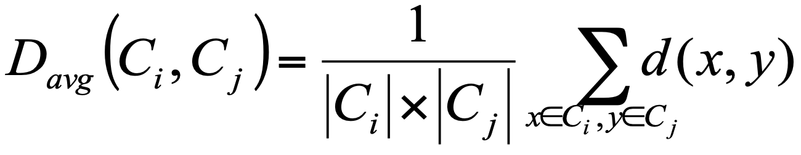
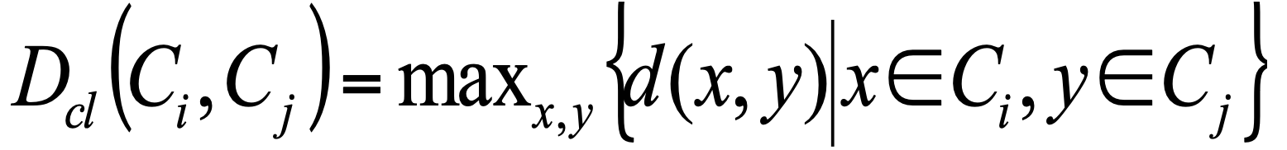
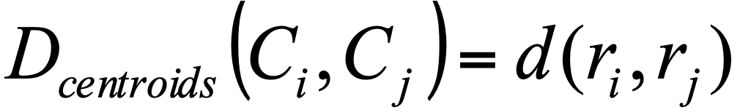
Distance between Clusters:
Linkage functions helps in determining the similarity score between two clusters
Single Linkage | Complete Linkage | Average Linkage | Centroid Linkage
Compute all pairwise distance between the observations in cluster A and the observations in cluster B, and record the smallest of these distance | Compute all pairwise distance between the observations in cluster A and the observations in cluster B, and record the largest of these distance | Compute all pairwise distance between the observations in cluster A and the observations in cluster B, and record the average of these distance | Distance between the centroid for cluster A (a mean vector of length p) and the centroid for cluster B.
Formula: | Formula: | Formula: | Formula:

Slide 26
How will you calculate the distance between a point and a cluster?

Slide 27
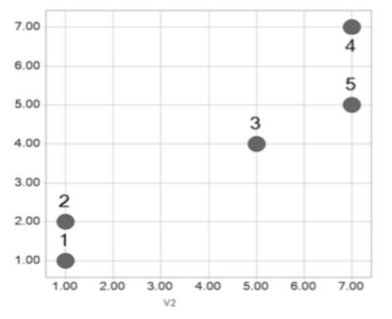
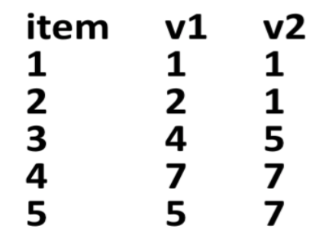
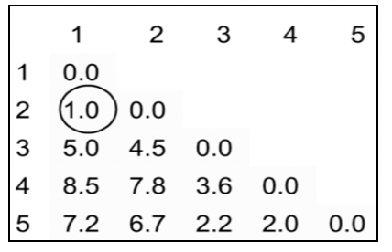
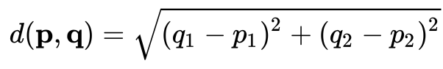
Let’s come back to Agglomerative Clustering: Example – Step by Step:
Two variable, n=5 items:
Euclidean distance matrix:

Slide 28
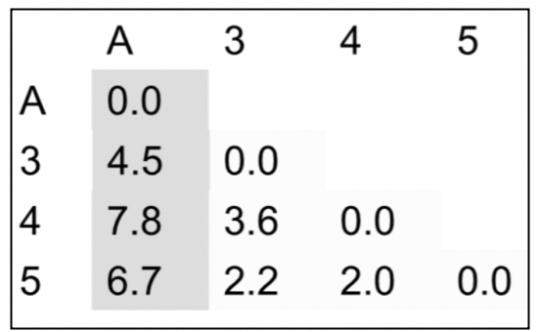
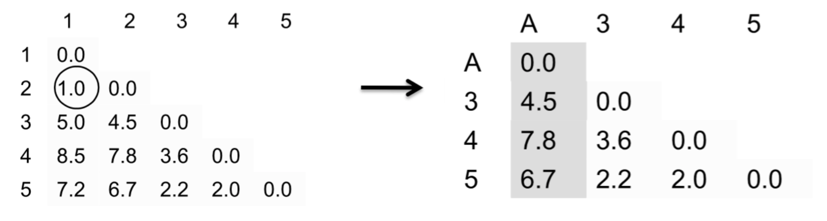
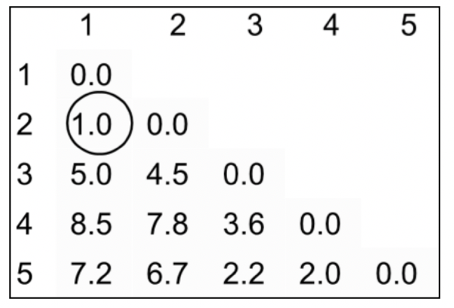
Step 1
Merge 1 & 2 into cluster A
Use single linkage to compute distances from cluster A

Slide 29
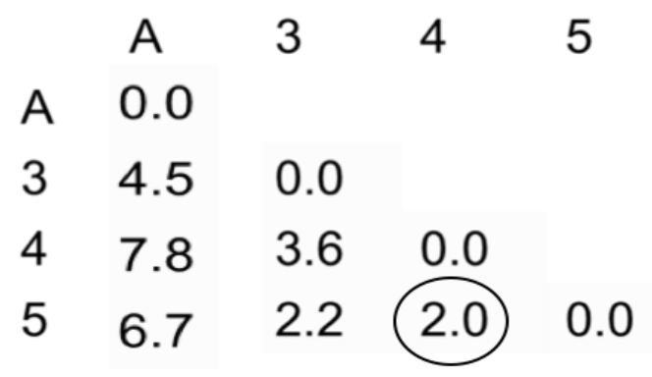
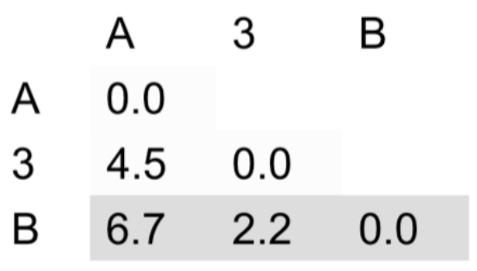
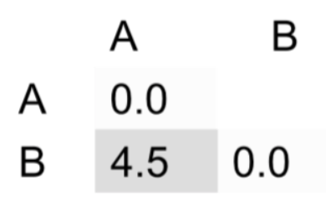
Step 2 & Step 3:
Merge 4 & 5 – cluster B
Distance (3 and 5) = Distance (3 and B)
Distance (3 and A(2)) = Distance (B and A)
Merge 3 and B

Slide 30
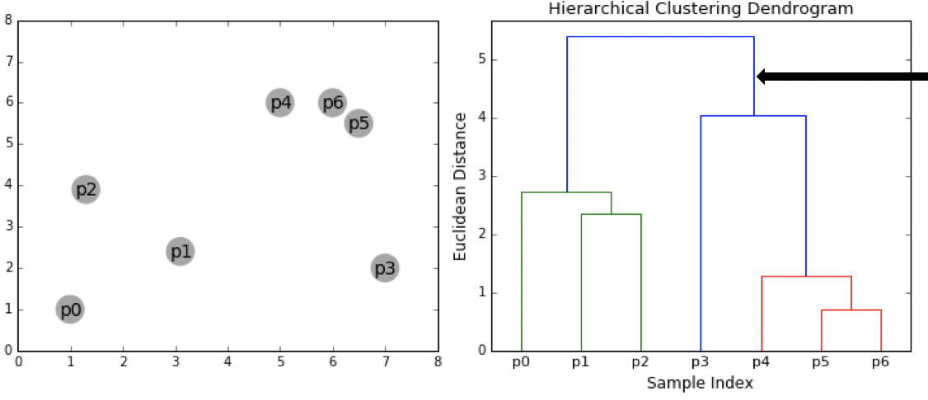
Significance of height of branch in Dendrogram:
Ex - Height of p3 to the cluster of p4,p5,p6 is ~4, which we can see from above picture
Height of branch denotes the distance the clusters/points merging at the level

Slide 31
Let’s go back to Case Study

Slide 32
Disadvantages of Hierarchical Clustering
It is not possible to undo the previous step: once the instances have been assigned to a cluster, they can no longer be moved around.
Time complexity: not suitable for large datasets
Very sensitive to outliers

Slide 33
Practical Issues with Clustering
Should the observations or features first be standardized in some way?
In the case of hierarchical clustering:
What dissimilarity measure should be used?
What type of linkage should be used?
How many clusters to choose? (in both K-means or hierarchical clustering). Difficult problem. No agreed-upon method.

Slide 34

Conclusions
Unsupervised learning is important for understanding the variation and grouping structure of a set of unlabelled data, and can be a useful pre-processor for supervised learning
It is intrinsically more difficult than supervised learning because there is no gold standard (like an outcome variable) and no single objective (like test set accuracy)
It is an active field of research, with many recently developed tools such as self-organizing maps, independent components analysis and spectral clustering.

Slide 35
Questions?

Slide 36
You guys were awesome! ☺

